Slide 1
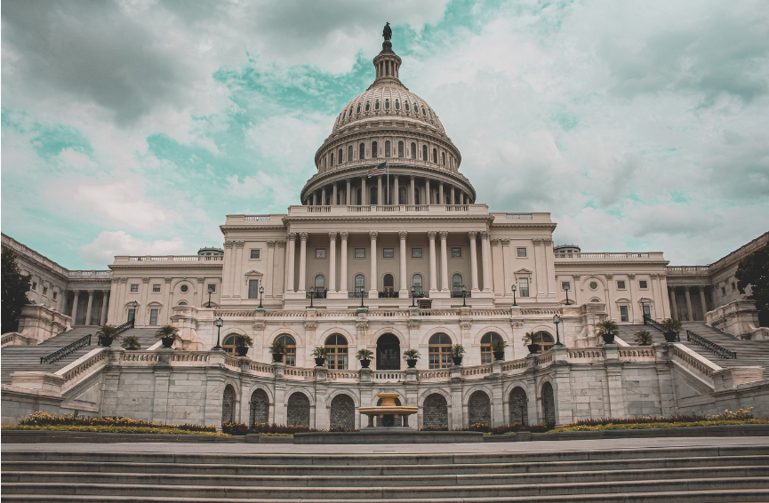
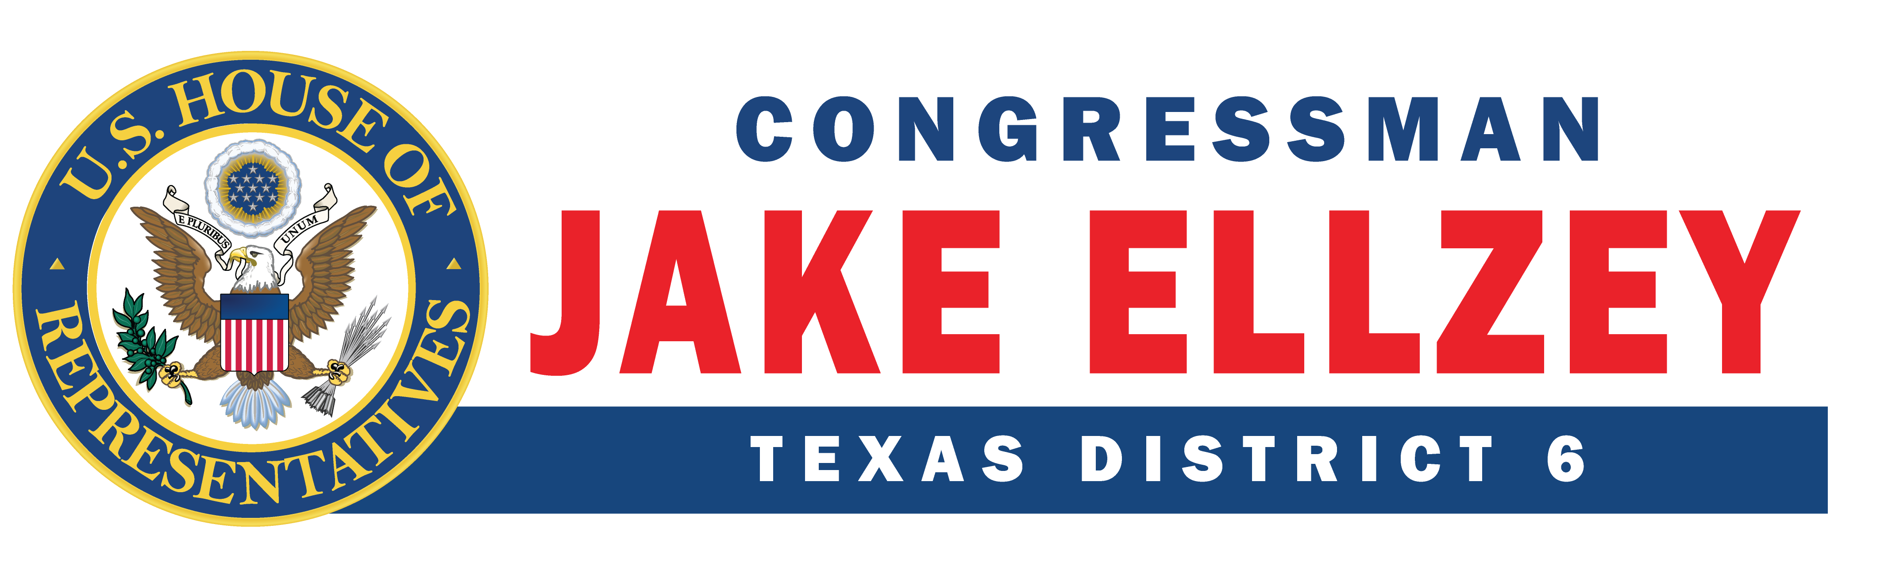
Office of Congressman Jake Ellzey Community Project Funding FY27

Slide 2

CPF Vs. Grant

Slide 3
What is community Project Funding
Community Project Funding is defined as spending provisions in federal legislation that is done on behalf of constituents or constituent organizations by a Member of Congress. The funding for these projects is from federal appropriations approved by Congress allowing local projects aiming to improve the lives of the community come to fruition.

Slide 4

Appropriations Timeline for FY27
Deadline for submissions: March 15th, 2026.
President’s Budget is announced in March/April.
Subcommittees start drafting bills.
Mark Ups occur in May, June, July, and September.
Government spending deadline is September 30th every year.

Slide 5

How to apply
Contact our District and DC staff
Our website will have a link to the form, this link will also be sent out via email
  Operational March 1st
  Website: ellzey.house.gov
Deadline to apply is March 15th at 6:00 P.M.
March

Slide 6


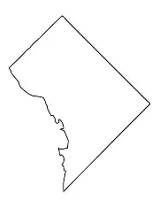
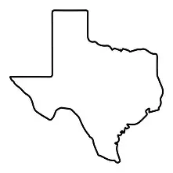
Office Guidelines for Submissions
The Congressman is only allowed 15 CPF submissions
Applications must be 100% correct
General District Nexus
Reach out early to both DC and District Teams
No late submissions
15
100%

Slide 7
Committee Guidelines
Cap on Overall Funding
  The total amount for Community Project Funding in House Appropriations Bills cannot exceed 0.5% of discretionary spending
Funding decisions will depend on the availability of funds, demand for projects, and merit of individual projects
Targeted projects of modest size can have meaningful impact for communities and likely have a greater chance of being funded
One-year projects only: Each project request must be for Fiscal Year 2027 funds only and cannot include multi-year funding
Funding Limits

Slide 8
Committee Guidelines
Not Eligible
  Memorials, museums, commemoratives (projects named after individuals or entities)
  Ban on For-Profit Recipients: Project funding may not be directed to for-profit recipients
Eligible Alternatives:
  Many projects can apply for competitive grants instead, Members can request higher program funding levels
Stewardship Requirements:
  Funded projects will follow applicable requirements in the authorized programs that support good stewardship of taxpayer dollars
  For example, programs may require a non-federal cost-share and participation in program audits
Restrictions & Stewardship

Slide 9

Subcommittee Guidance
There are 12 Subcommittees on Appropriations, only 7 accept CPFs
Agriculture
Commerce, Justice, Science
Energy and Water Development*
Interior and Environment
Homeland Security
Military Construction and Veteran Affairs*
Transportation and Housing and Urban Development

Slide 10


Agriculture
This subcommittee will only consider projects for funding recipients that are state, local, and Tribal organizations, or conservation districts.
Non-profit recipients will not be considered
Department of Agriculture:
  Rural Development
    Community Facilities Grants
    ReConnect Program
    Distance Learning and Telemedicine Grants
    Water and Waste Disposal Grants
  Agricultural Research Service Buildings and Facilities
  Natural Resources Conservation Service, Conservation Operations

Slide 11


Commerce, Justice, Science
Department of Commerce – National Institute of Standards and Technology (NIST) – Scientific and Technical Research and Services – Scientific and Technical Research
Department of Commerce – National Oceanic and Atmospheric Administration (NOAA) – Operations, Research, and Facilities – Coastal Zone Management
Department of Justice (DOJ) – Office of Justice Programs (OJP) – State and Local Law Enforcement Assistance – Byrne Justice Assistance Grants (Byrne JAG)
Department of Justice (DOJ) – Community Oriented Policing Services (COPS) – Technology and Equipment
National Aeronautics and Space Administration (NASA) – Safety, Security and Mission Services (SSMS)

Slide 12

Interior and Environment
Environmental Protection Agency – State and Tribal Assistance Grants (STAG)

Slide 13


Homeland Security
Federal Emergency Management Agency (FEMA)
  Pre-Disaster Mitigation (PDM) grants
  Emergency Operations Center (EOC) grants

Slide 14
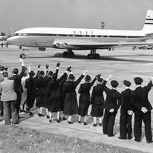
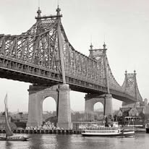
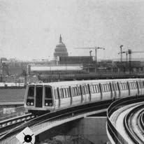
Transportation and Housing and Urban Development
Department of Transportation includes:
  Airport Improvement Program
  Highway Infrastructure Projects
  Consolidated Rail Infrastructure and Safety Improvements
  Transit Infrastructure Grants
  Port Infrastructure Development Program
Department of Housing and Urban Development – Economic Development Initiatives

Slide 15
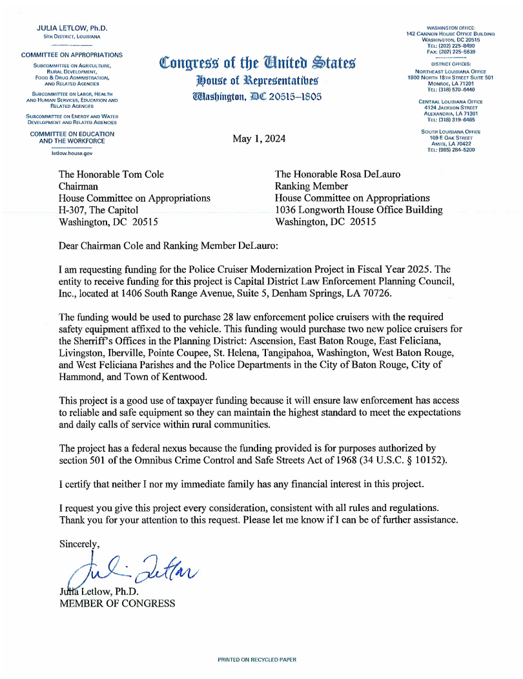
Examples of approved Cpf
Julie Letlow (LA-05)
  Intended Recipient: Capital District Law Enforcement Planning Council, Inc.
  Requested Amount: $1, 400,00
  Project Description: This funding would be used to purchase 28 law enforcement police cruisers with the required safety equipment affixed to the vehicles. This funding would purchase two new police cruises for the multiple offices.

Slide 16
Examples Continued
Dale Strong (AL-05)
  Huntsville West Aviation Center
  Requested Amount: $10,000,000
Project Description: This project will allow Huntsville International Airport to make improvements to include an aircraft apron and connector taxiway to initiate development of the west side of the airport.
Ashley Hinson (IA-02)
Project Name: Belle Plaine Drinking Water Resiliency Project
Request Amount: $4,000,000
Project Description: These funds will support necessary upgrades to the City of Belle Plaine’s drinking water infrastructure to provide clean, reliable, and abundant drinking water to the 2,300 residents of Belle Plaine, Iowa.

Slide 17
Grant Services our office offers
The Federal government sends back taxpayer dollars every year in the form of grants
These are opportunities for nonprofits, local governments, and state governments to receive federal dollars
How our office can support you:
  Clarify eligibility requirements and application processes
  Sharing updates as new funding opportunities are released
  Aide in research on behalf of the organizations that need funding
  Provide letters of support for applications in progress
  Connect you with federal agency contacts for technical questions

Slide 18
Grant application Process
Each grant has three phases:
Pre-Award Phase
Award Phase
Post-Award Phase
It’s important to determine your eligibility to apply for a grant so that no time is wasted applying for something you cannot receive

Slide 19
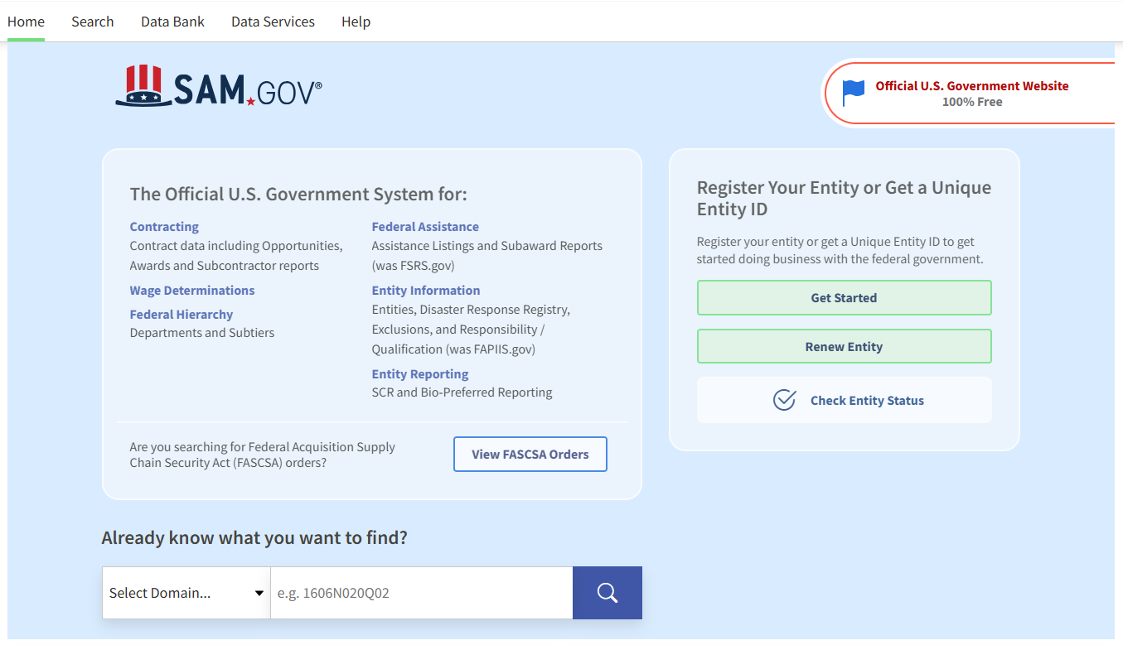
Getting started
During the Pre-Award Phase you will need to register to apply for a grant at www.SAM.gov
At SAM.gov you will receive a Unique Entity Identifier (UEI)
This process can take up to two weeks or more to fully complete, so plan accordingly
Annual renewal required to stay active

Slide 20
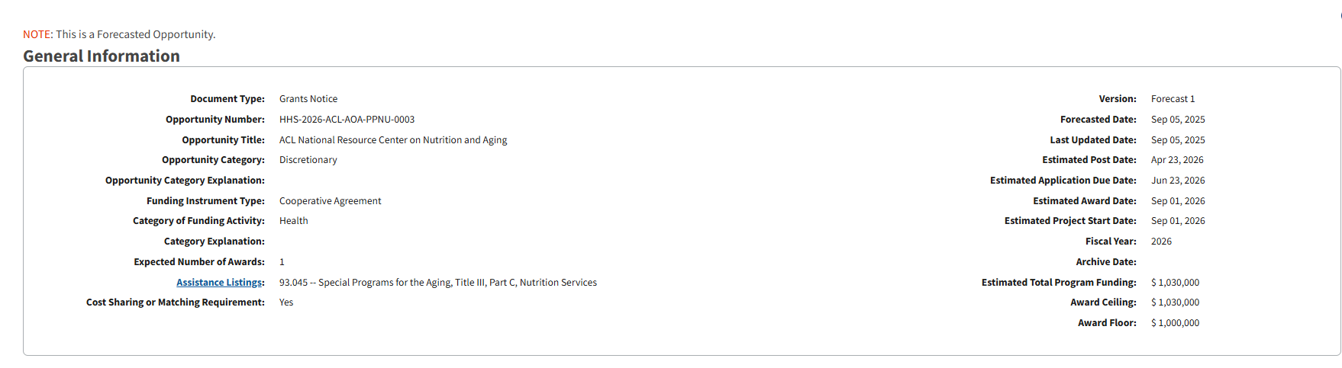
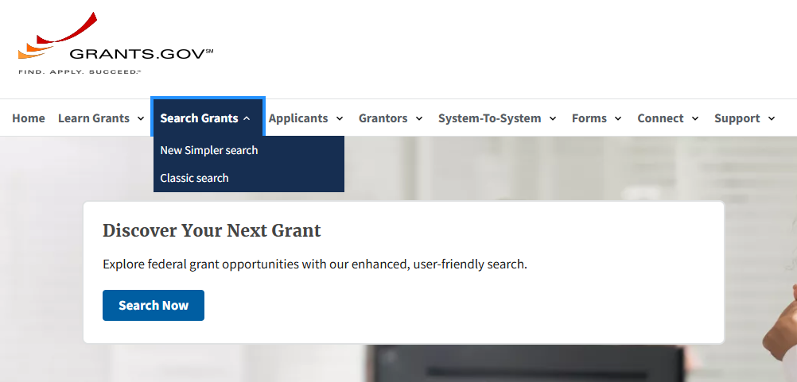
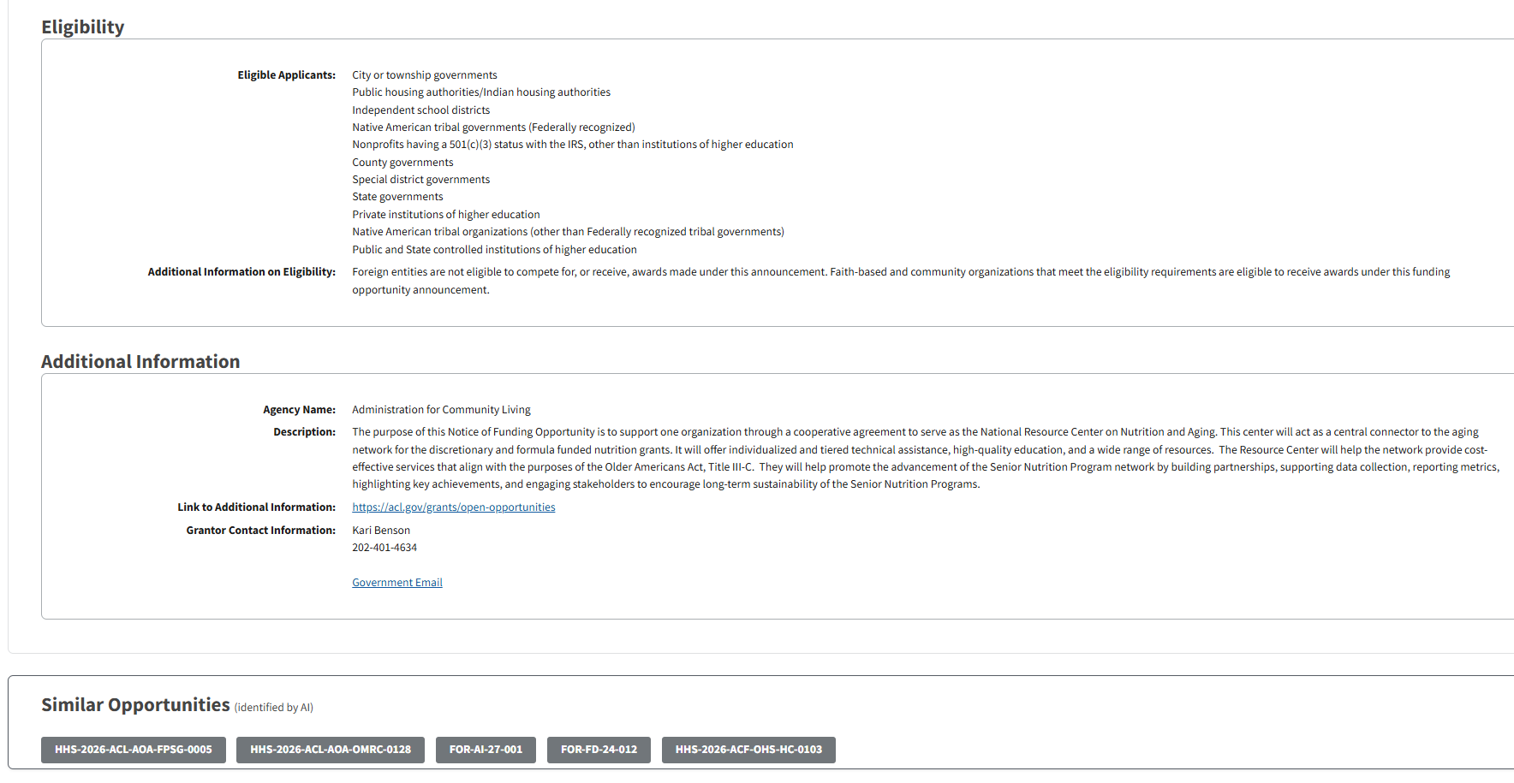
grants.gov

Slide 21
Takeaways for a Strong Application
Allow time for assembling required documents
Double check eligibility
Provide credible statistics and community benefit examples to support the proposal
In addition to grants.gov, each federal agency has the option to sign up for alerts as grants are released or updated

Slide 22
Constituent Services our Office offers
Casework – our office can help with over 400 federal agencies, of those we receive the most request for help with Social Security, Medicare, Veteran Affairs, IRS, USCIS, Passports, SBA and more
Letters of Recognition – our office honors those who are doing amazing work in the district – honoring outstanding teachers, students, first-responders, community members and leaders
Supporting local nonprofits – our team is always looking for opportunities to volunteer and help further the mission of our district’s hardworking nonprofits
Overall, our office sets out to coordinate resources for constituents in need, if we cannot directly help them with the issue, we connect them with the necessary resources

Slide 23
Staff Contacts
DC Appropriations Contact
TX06appropriations@mail.house.gov
Julie Loose, District Director
(Julie.loose@mail.house.gov)
Constituent Services
(TX06casework@mail.house.gov)
Hailee Swalm, Grant Coordinator
(hailee.swalm@mail.house.gov)

Slide 24
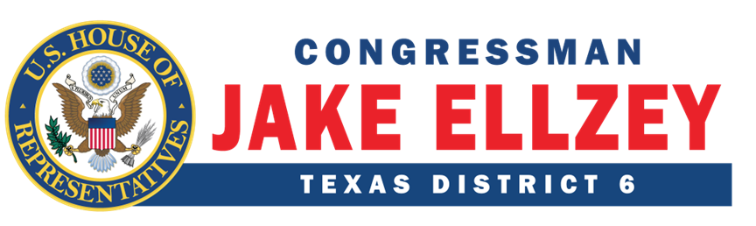
Thank you for Attending!

